Slide 1
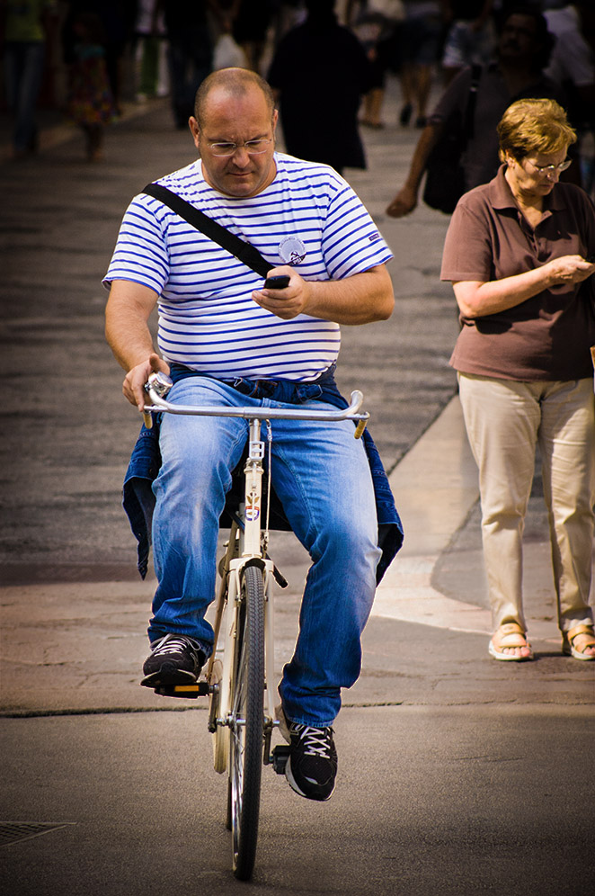


Problem
‘how can citizens (e.g. cyclist) provide information about the infrastructure facilitates in the Netherlands without significant extra effort and without endangering their safety’

Slide 2

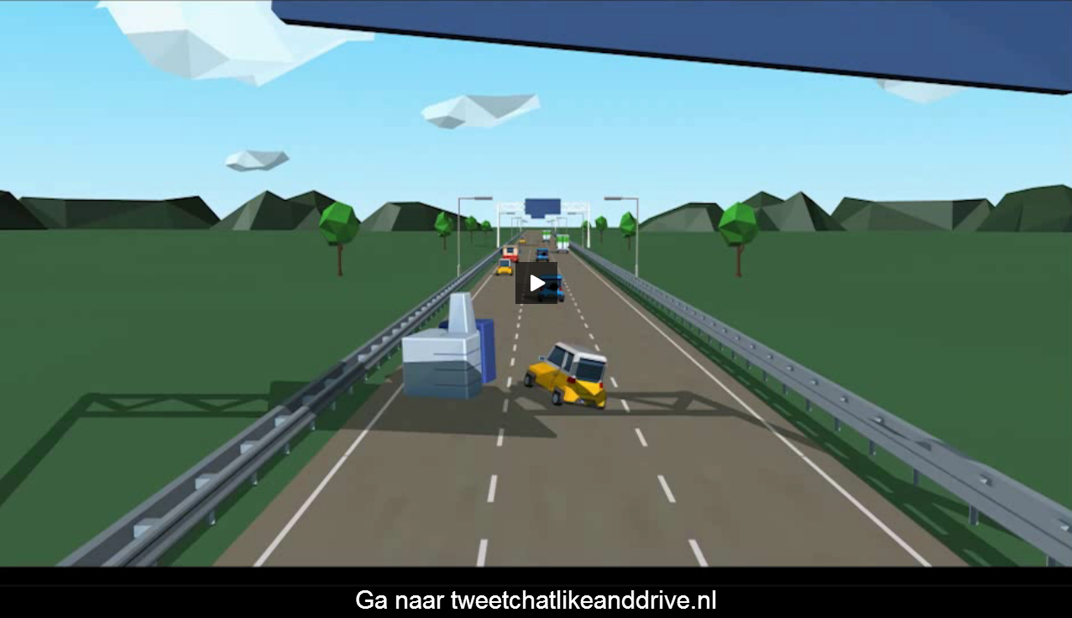
Policy / Paradigm
Campagnes
Participation vs Social Media and traffic
Participation society
Safe transport

Slide 3
Facts social media and safety
4 million Dutchmen (51% of smartphone users) use the smartphone during traffeling by car or public transportation.
1 of 3 uses smartphone while driving a car.
SWOV calculates use of smartphone result in dead for 30/40 people.
50% of Dutch bikers read social media message during biking and 35% does send a message
1 of 10 accidents with bikes is due to smartphone use
Source: VVN

Slide 4
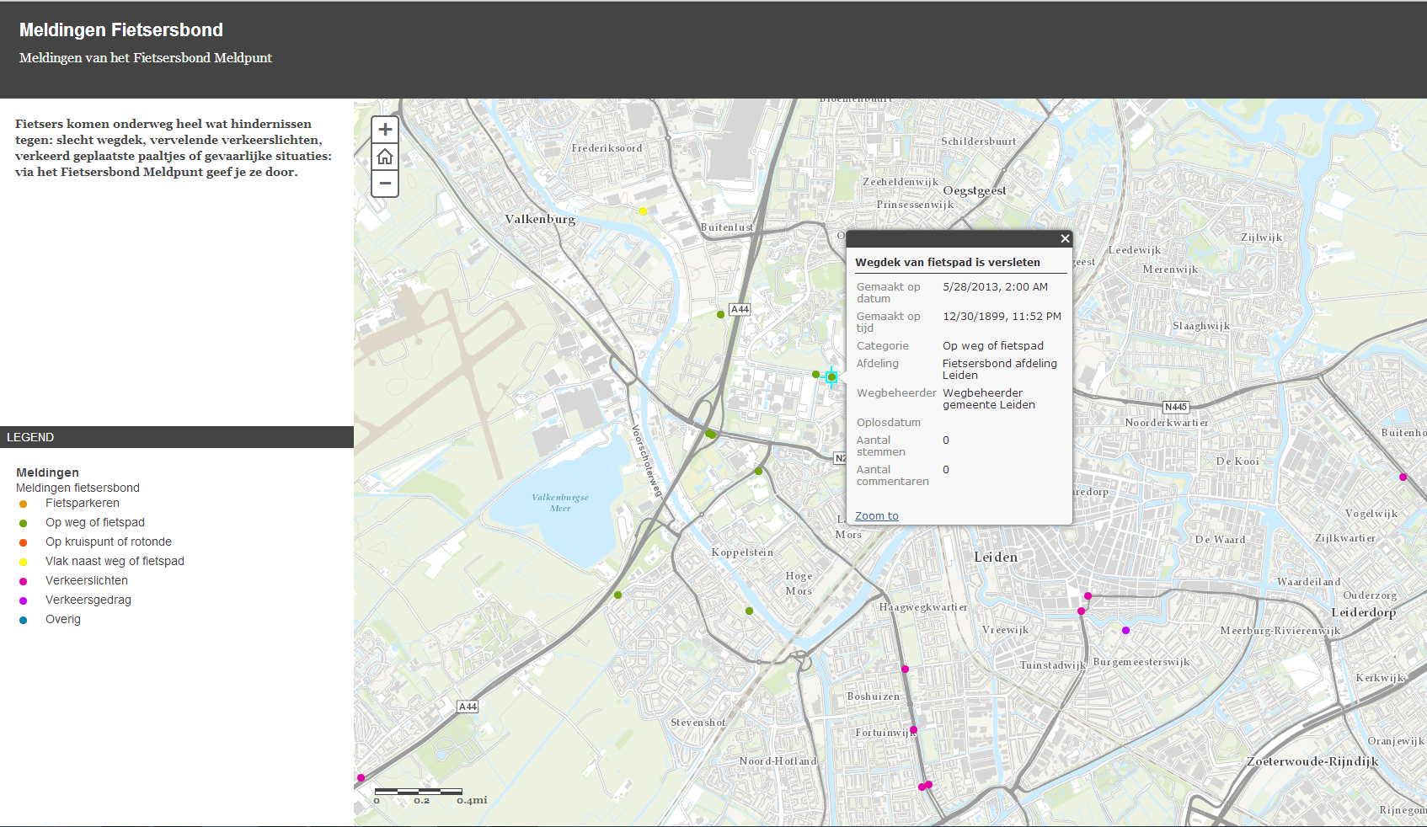
Use of Social Media
Crowd sourced information
Fietsersbond

Slide 5
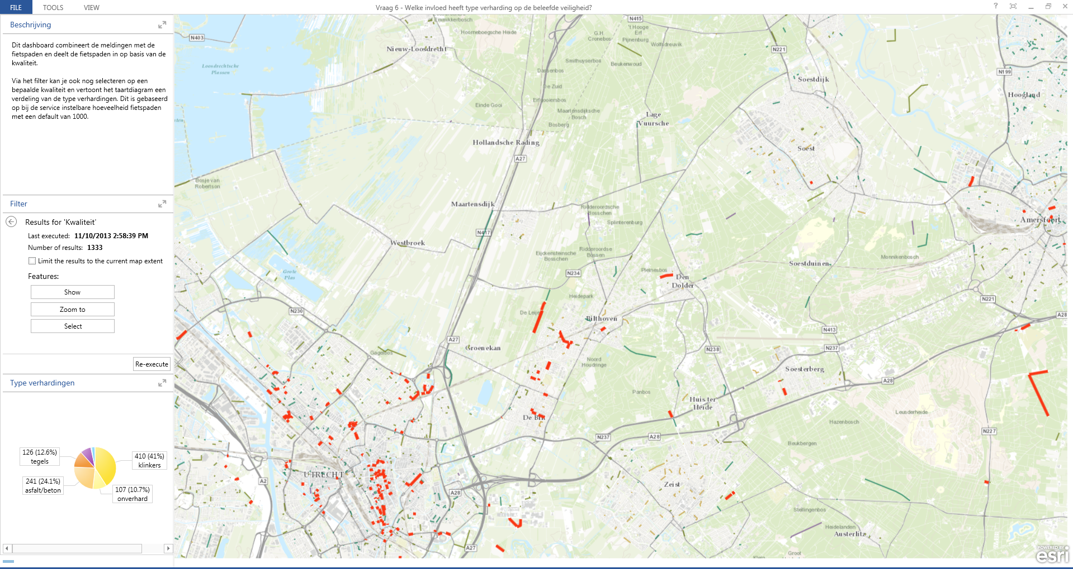
Intelligent analyses on data
Embed social information in maintenance processes

Slide 6
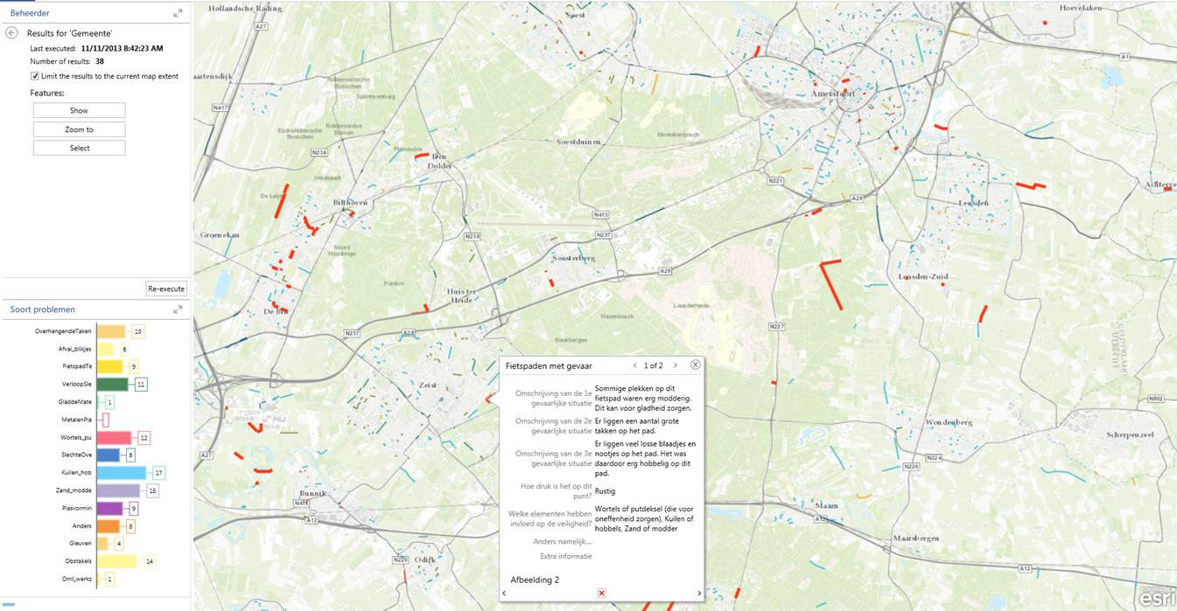
Roamler comments

Slide 7
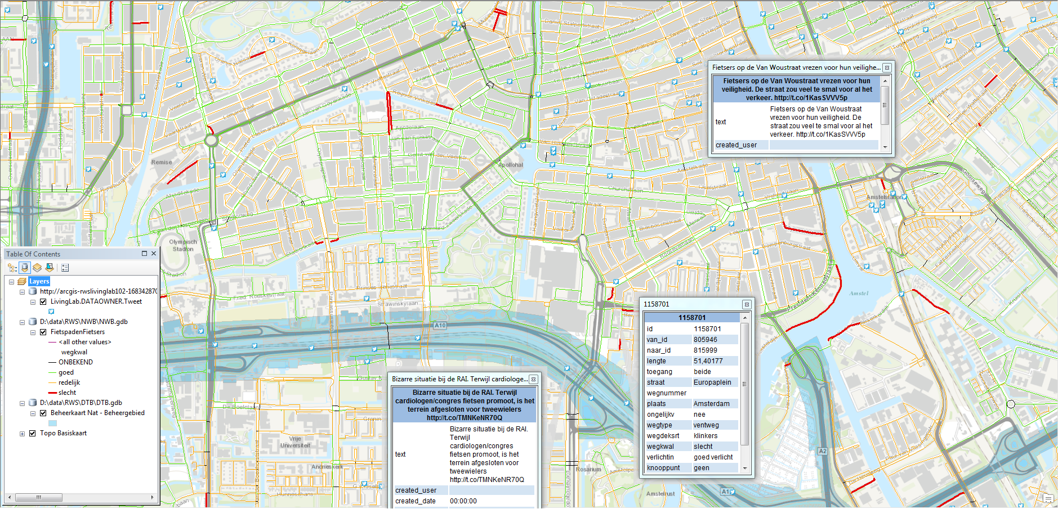
Use of social media
Crowdsourced information
Twitter and Fietsersbond

Slide 8
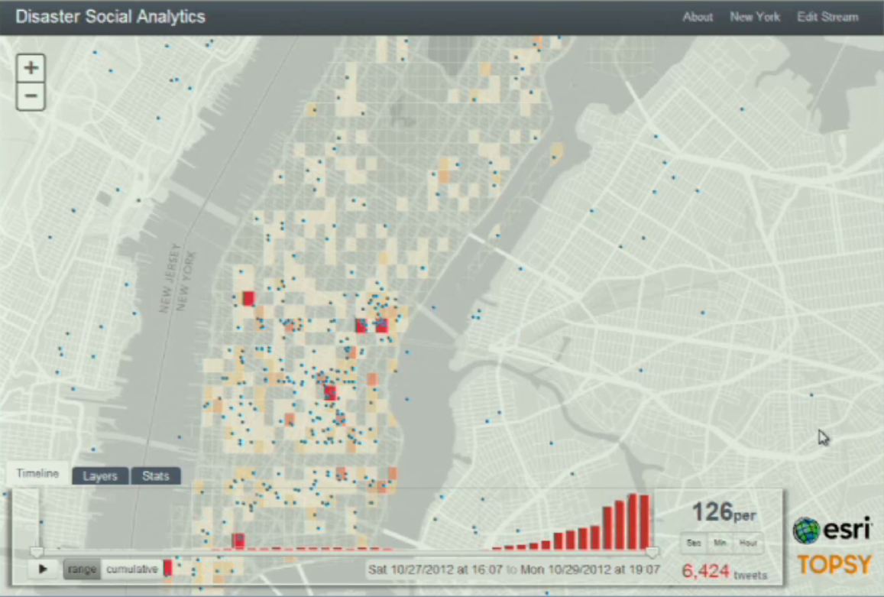
Use of social media
Movie

Slide 9
Goal of the workshop
Find a creative solution for biker participation by social media, but ensure safety
Stakeholders are civilians
Use of common devices (like smart phones)
Easy and user friendly
Safe Transport
Public Involvement
Notes:
e.g. stop cycling, measure the width of the road, send a message or fill in a form on a website

Slide 10
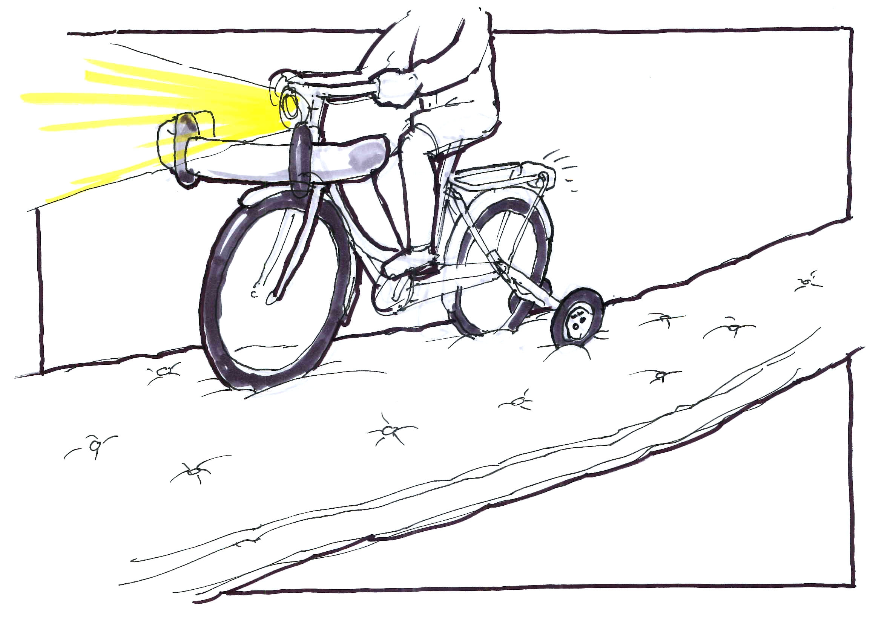
Unrealistic solutions

